Slide 1





SOLAR RADIATION PREDICTION
MADE BY:
HARNOOR KAUR-2210990374
HARSHITA BANSAL 2210990392
HEENA 2210990397
HIMANSHU 2210990405

Slide 2

Problem Statement
The problem at hand involves the development of an accurate and reliable predictive model for solar radiation. Solar radiation prediction is crucial for various applications, including solar power generation, weather forecasting, and agricultural planning. Traditional methods often struggle to accurately capture the complex interactions between atmospheric parameters, leading to limited prediction accuracy and reliability.
The ultimate goal is to develop a predictive model that can provide accurate and timely forecasts of solar radiation, enabling better decision-making in various sectors, including energy, agriculture, and environmental management. By addressing the challenges associated with solar radiation prediction, this research aims to contribute to the advancement of renewable energy technologies and support efforts to mitigate climate change and promote sustainable development.

Slide 3
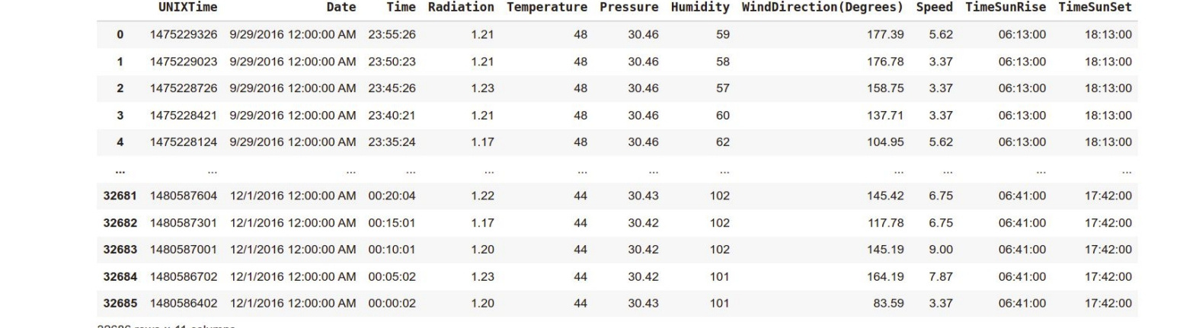
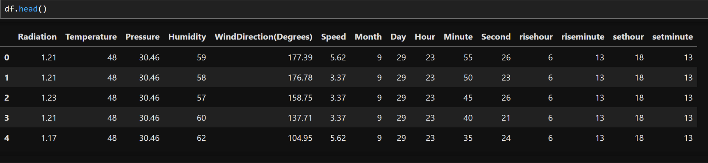
INTRODUCTION AND DATASET
Challenge: Solar power is great, but sunshine isn't always constant.
Solution: Predict how much sunlight (GHI) reaches a location.
GHI (Global Horizontal Irradiance): The total solar energy hitting a flat surface, including direct and scattered sunlight.
Why GHI matters: Knowing GHI lets us estimate how much electricity solar panels can generate.
Predicting GHI: Weather patterns like sunshine, pressure, wind, temperature, and humidity influence solar radiation. This connection allows us to build models to forecast solar power availability.
Original Dataset
Cleaned Dataset

Slide 4

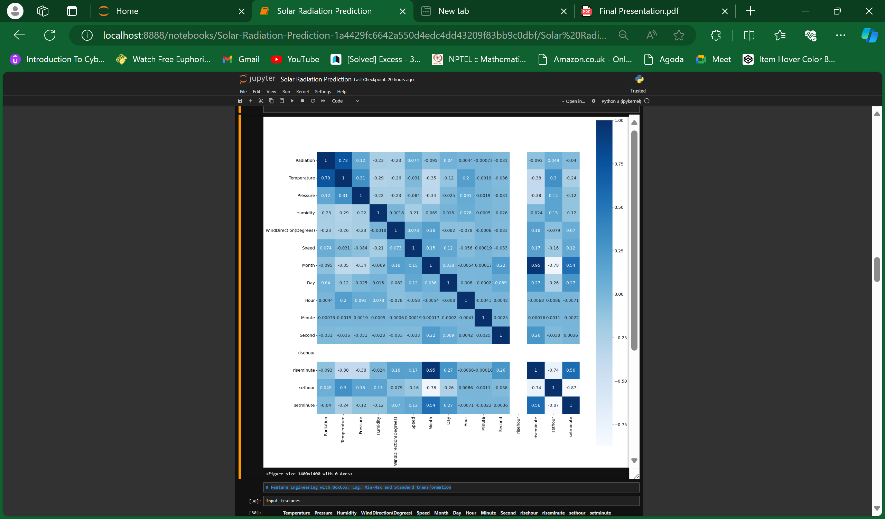
CORELATION
Temperature is the most significant variable positively correlated with Radiation.
Humidity has a moderate negative correlation with Radiation.
Rise Hour and Rise Minute are moderately correlated with each other.
Set Hour and Set Minute are strongly correlated with each other.
Most other variables have weak correlations with each other and with Radiation.

Slide 5
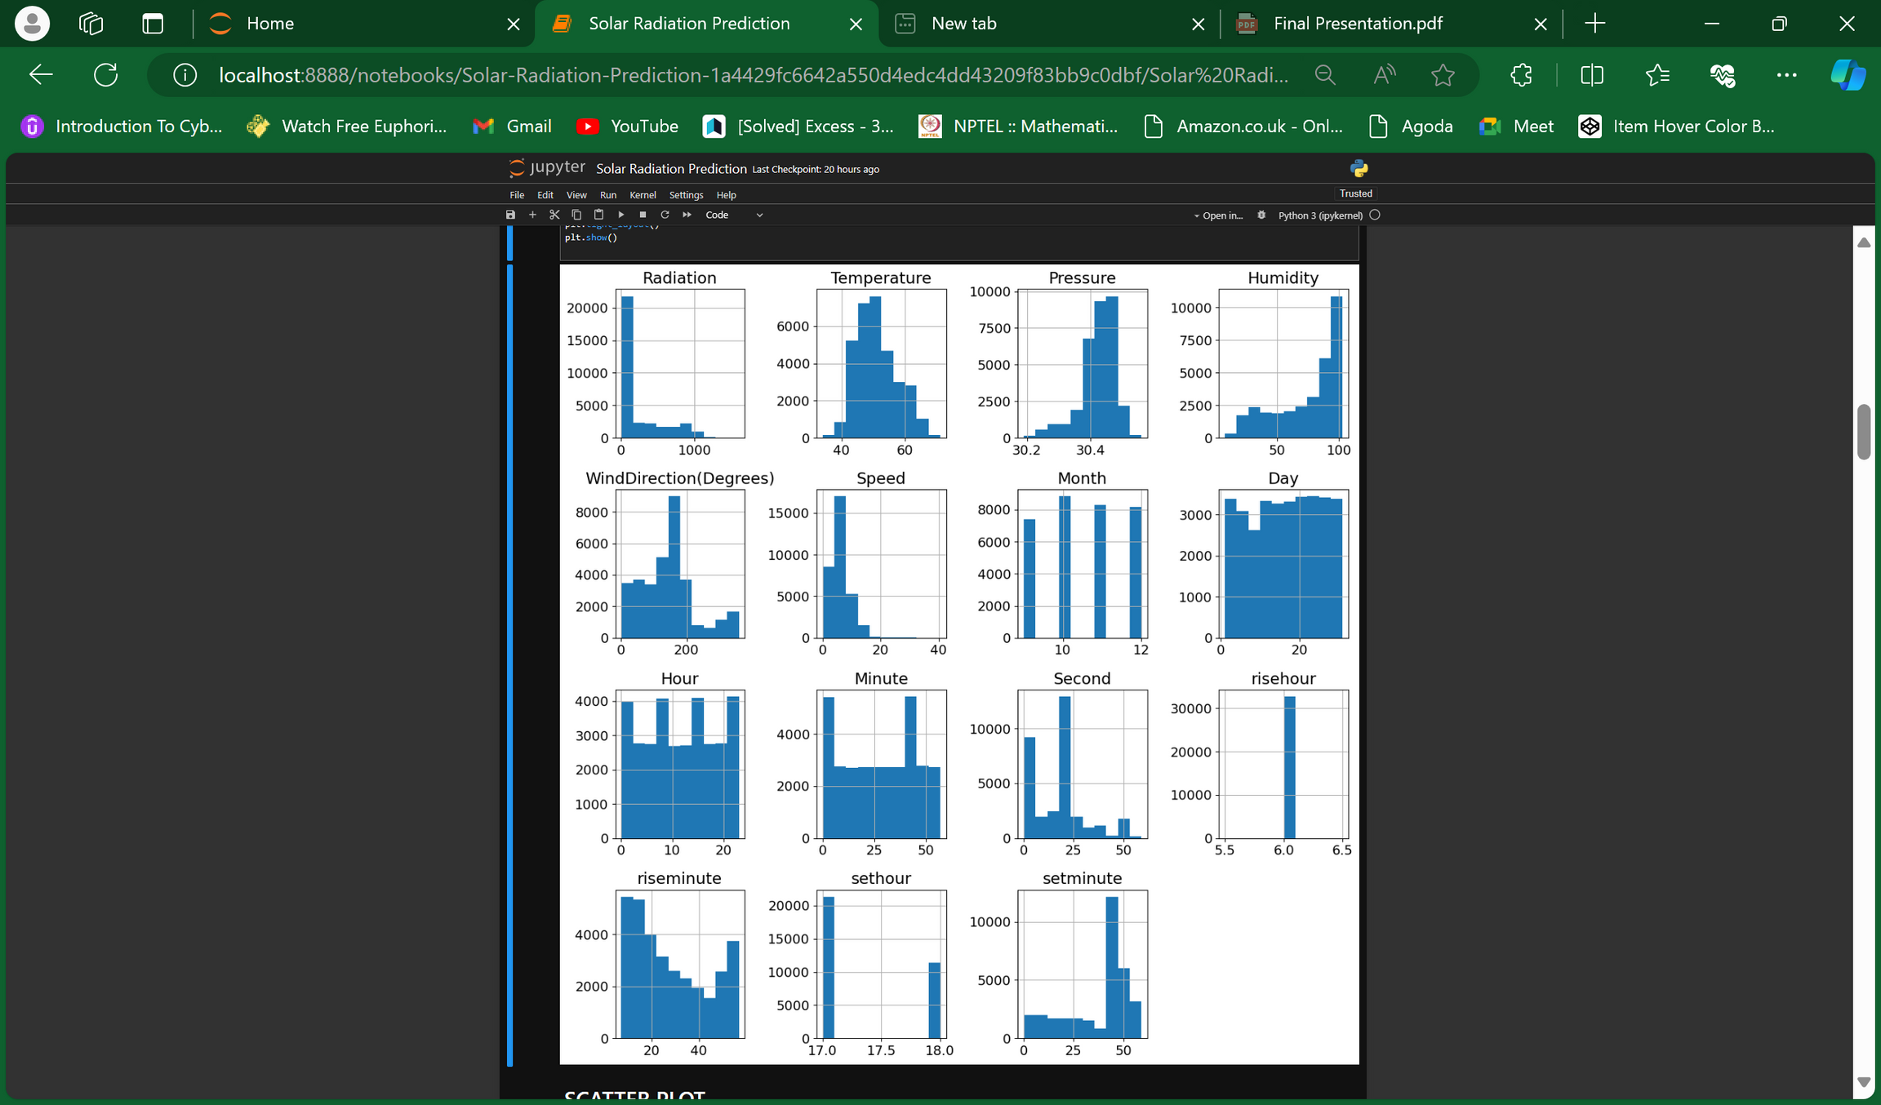
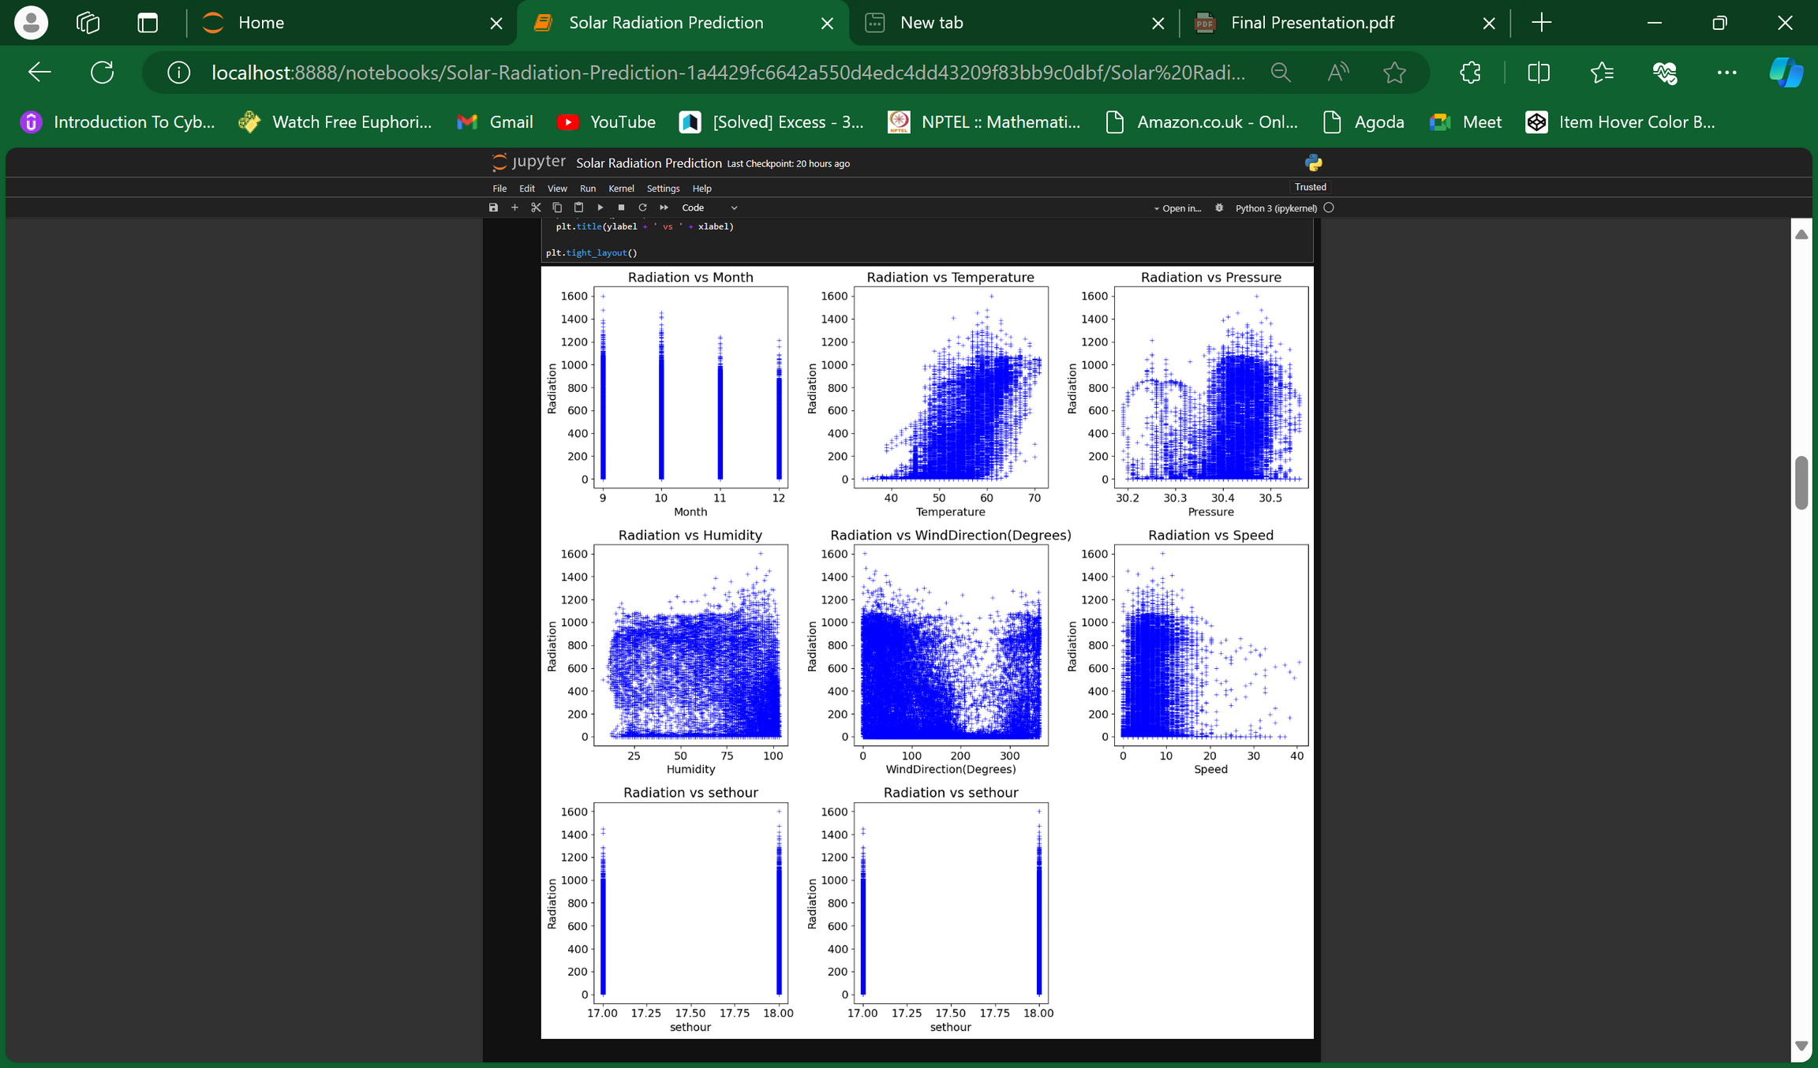
HISTOGRAM AND SCATTER PLOTS

Slide 6
Correctness of feature selection
ModelTest | R^2 score (without FS)Test | R^2 score (with FS)
SVR | 0.137 | 0.366
Linear Regression | 0.626 | 0.625
MLP Regressor | 0.817 | 0.825
Decision Tree Regressor | 0.872 | 0.874
Gradient Boost | 0.884 | 0.883
XGBoost | 0.930 | 0.931
Random Forest | 0.938 | 0.938
Key features for solar radiation prediction: Date (seasons), Time of Day (peaks at noon), Temperature (strongest correlation), Pressure (linked to temperature), Humidity, Wind Direction & Speed. Sunrise/Sunset times - not important.
After dropping the features that are judged as irrelevant by the statistical techniques, the R2 scores have either improved or have remained almost the same. As dimensional reduction is always advantageous we conclude that the feature selection is correct and the inferences derived regarding the dependencies of each selected feature with response variable are true

Slide 7
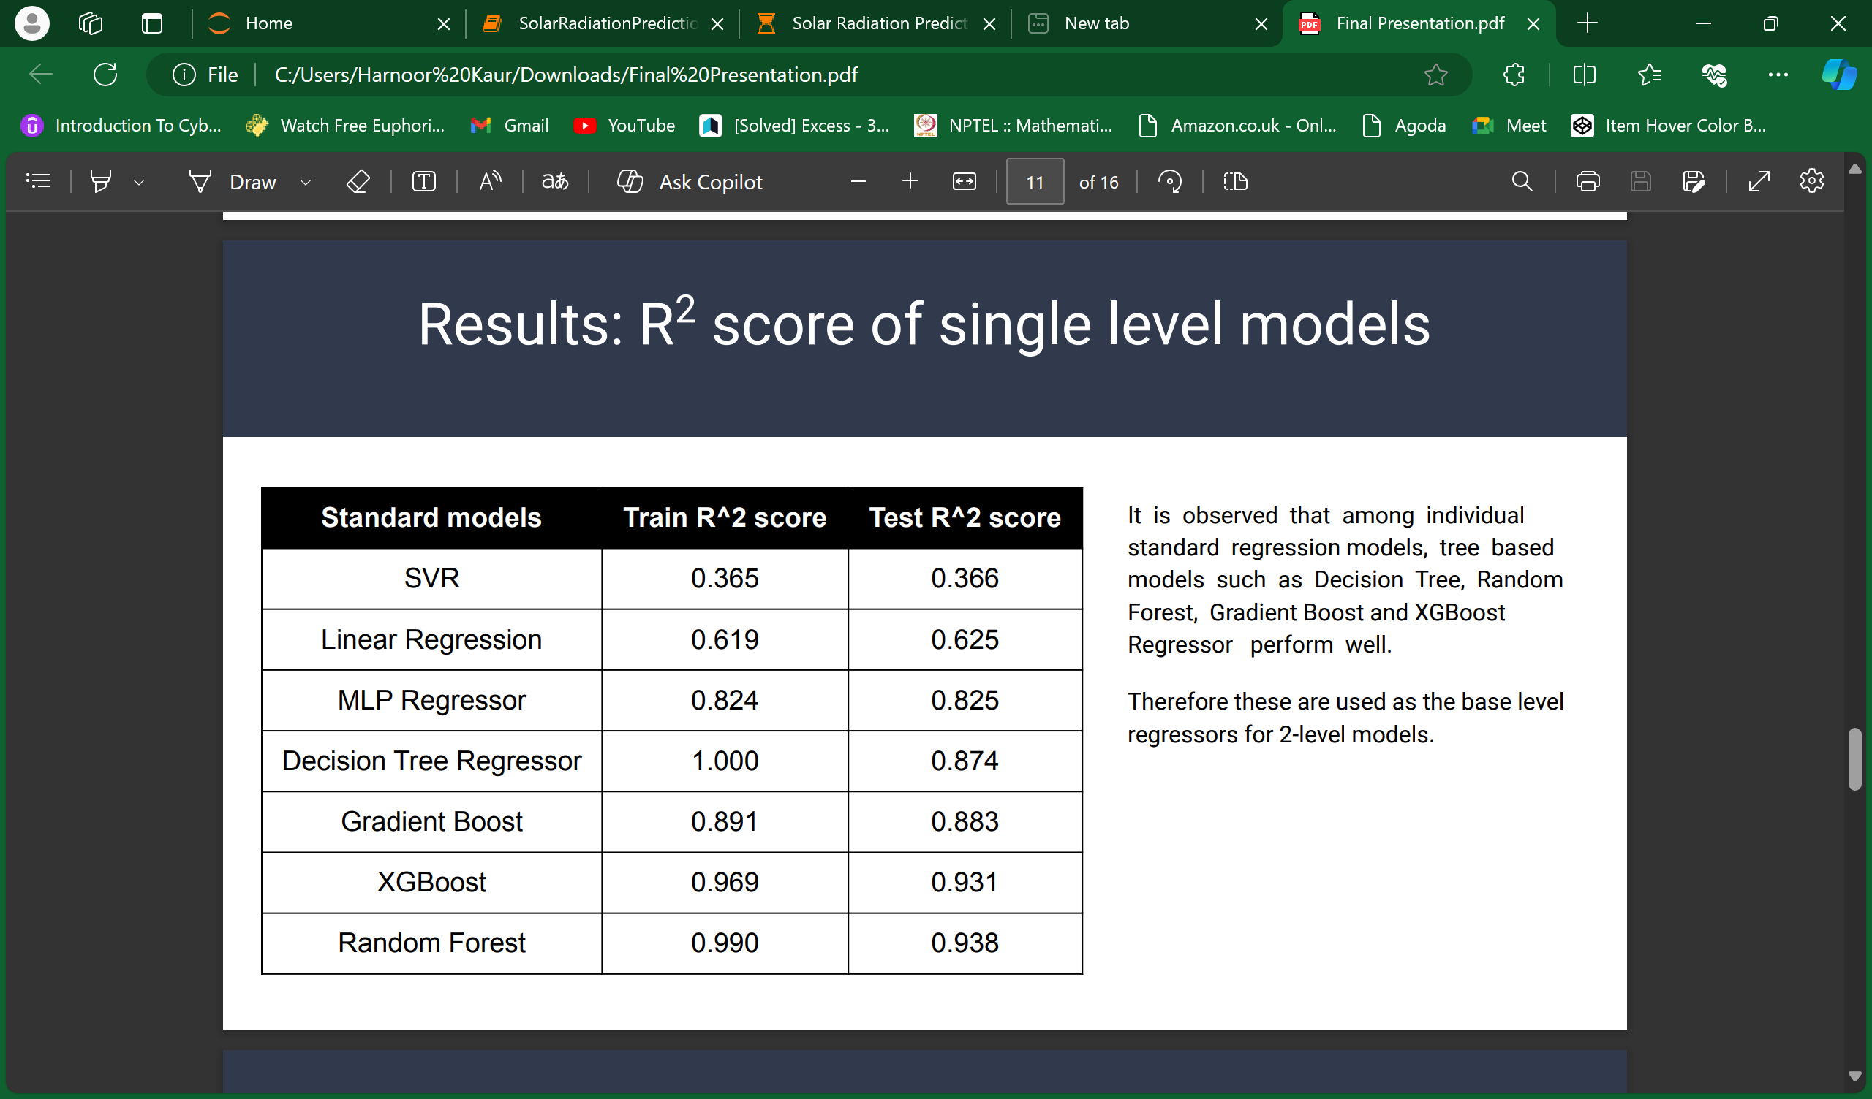
R2 score of single level models
It is observed that among individual standard regression models, tree based models such as Decision Tree, Random Forest, Gradient Boost and XGBoost Regressor perform well. Therefore these are used as the base level regressors for 2-level models

Slide 8


ARCHITECTURE
2 LEVEL
3 LEVEL

Slide 9
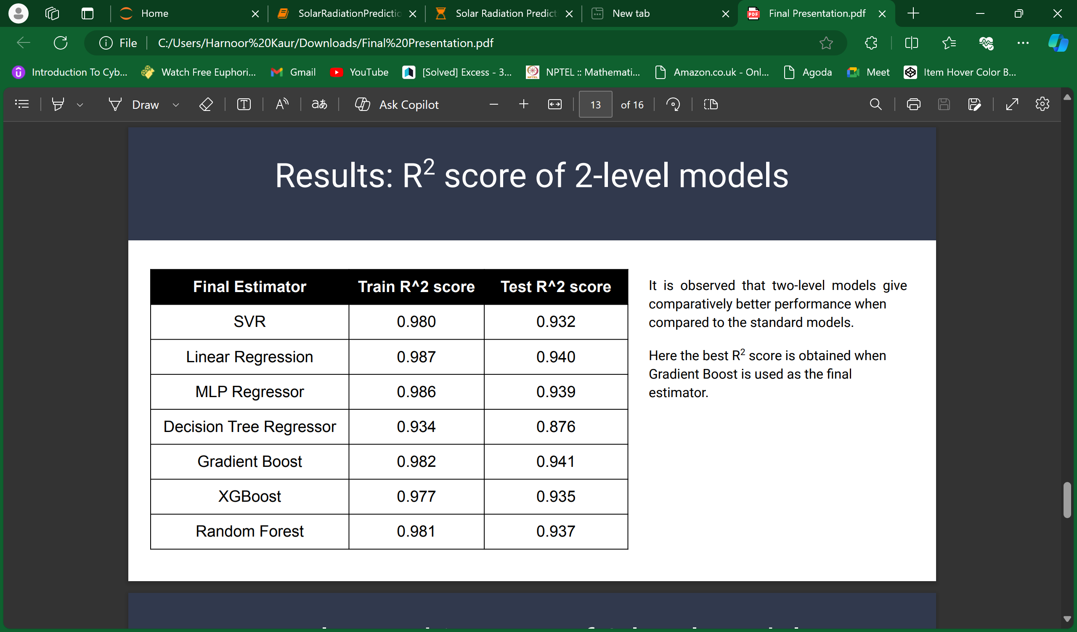
R2 score of 2-level models
It is observed that two-level models give comparatively better performance when compared to the standard models. Here the best R2 score is obtained when Gradient Boost is used as the final estimator

Slide 10
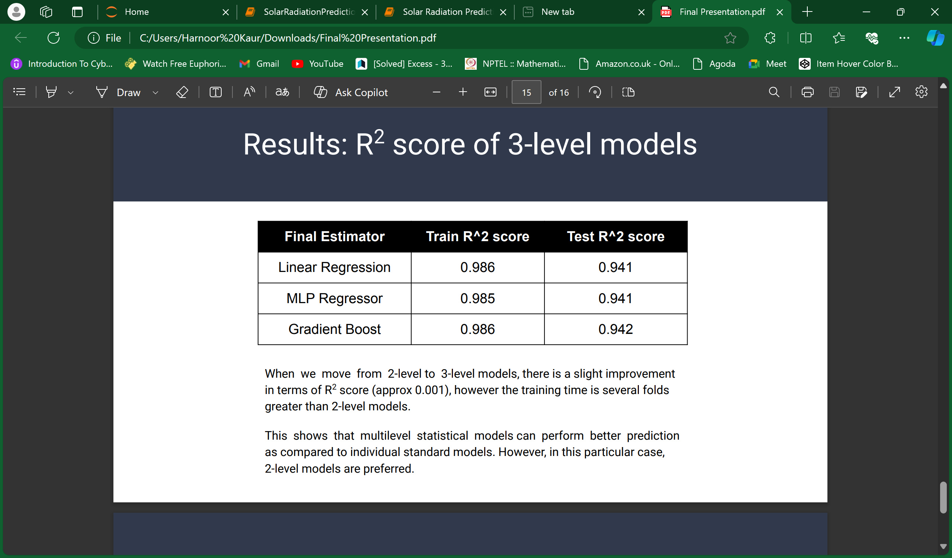
R2 score of 3-level models
When we move from 2-level to 3-level models, there is a slight improvement in terms of R2 score (approx 0.001), however the training time is several folds greater than 2-level models. This shows that multilevel statistical models can perform better prediction as compared to individual standard models. However, in this particular case, 2-level models are preferre

Slide 11
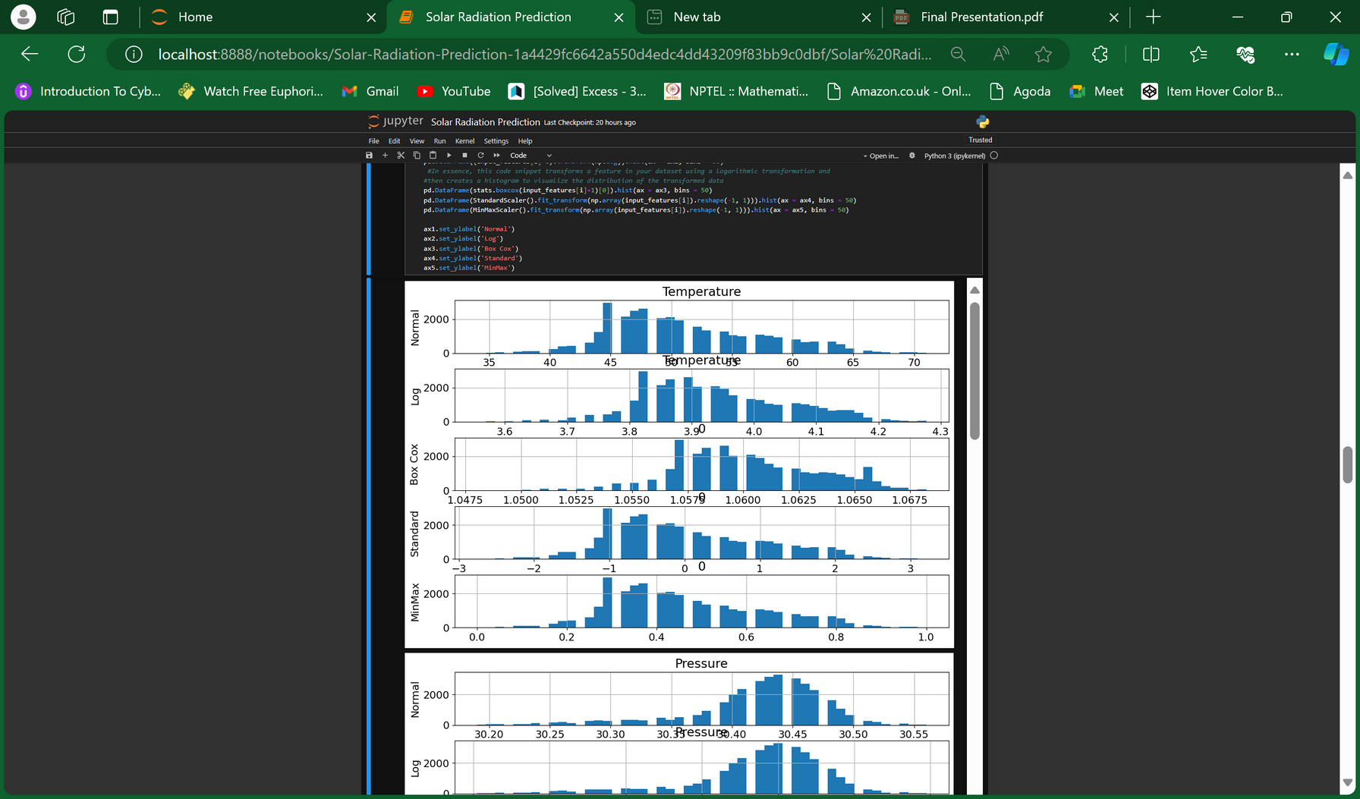
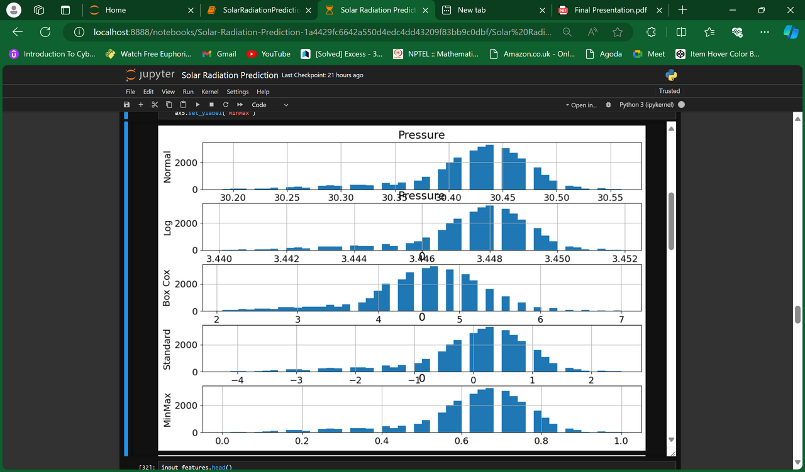
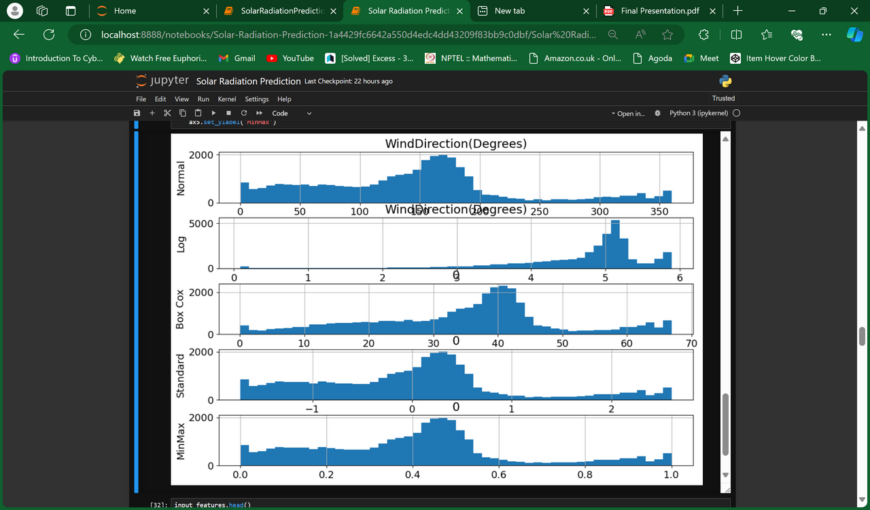
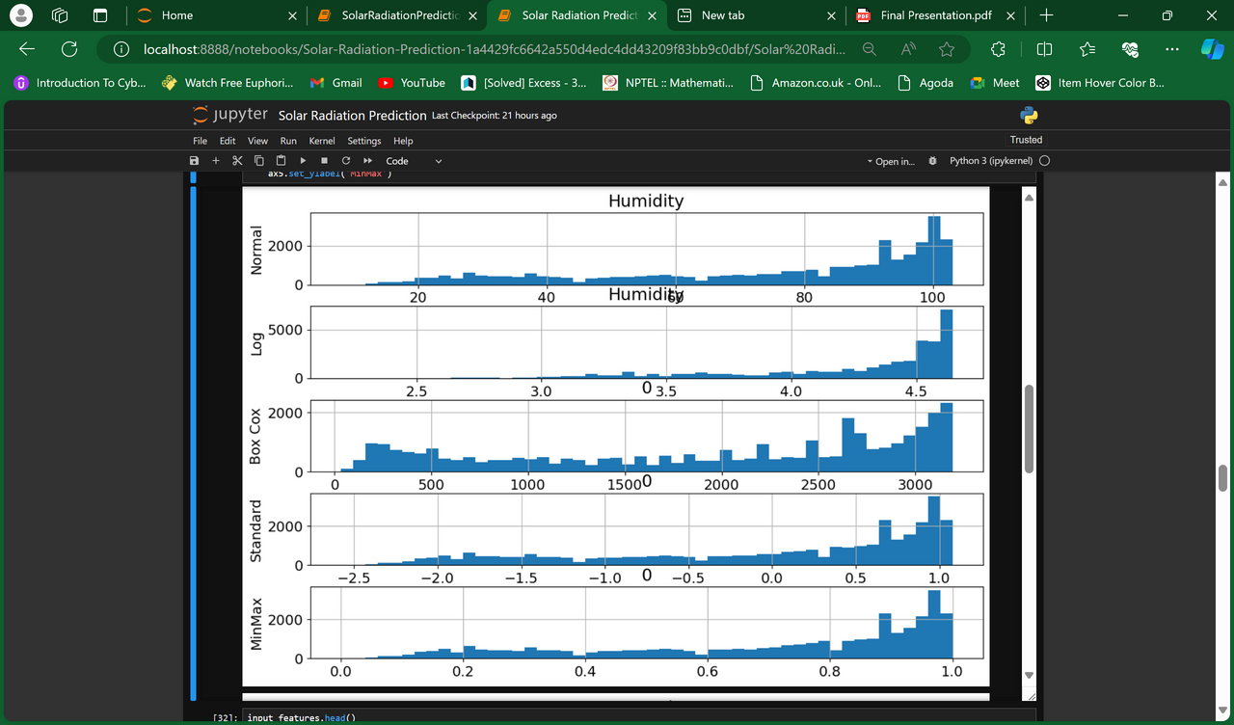
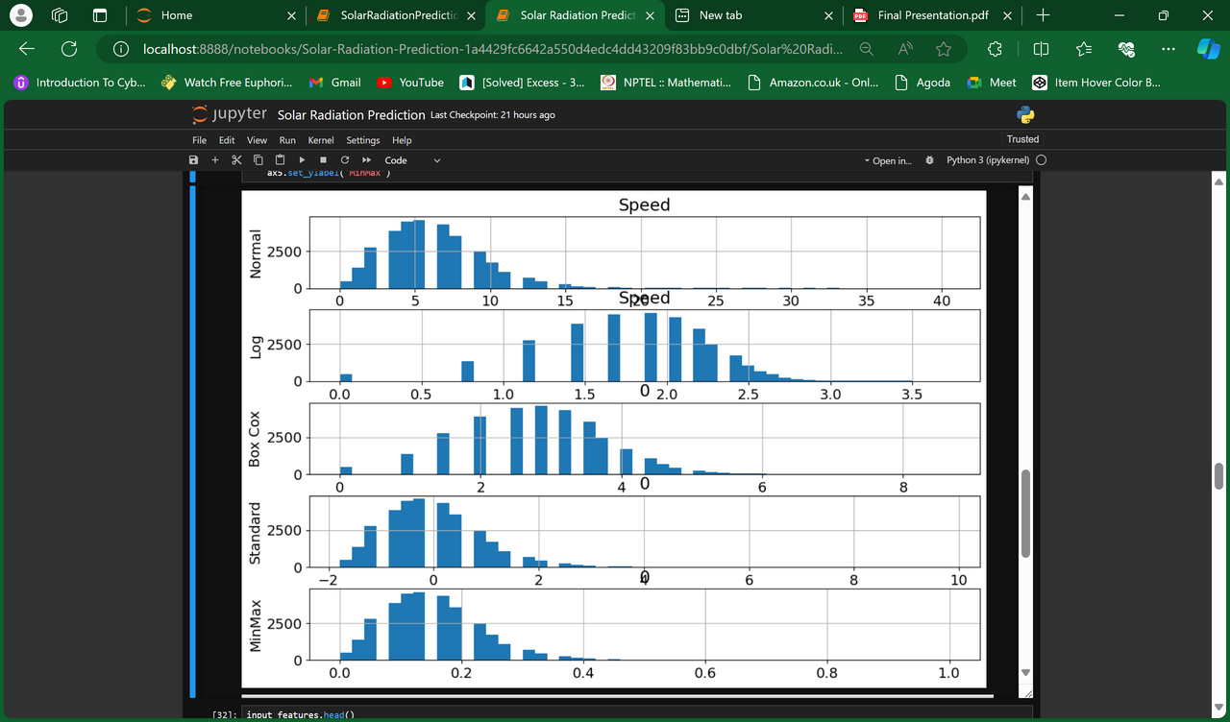
Feature Engineering with BoxCox, Log, Min-Max and Standard transformation

Slide 12
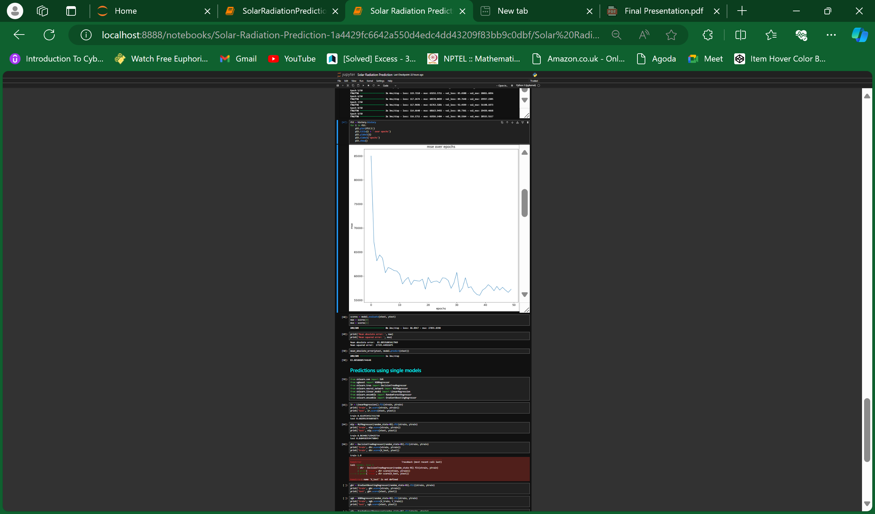
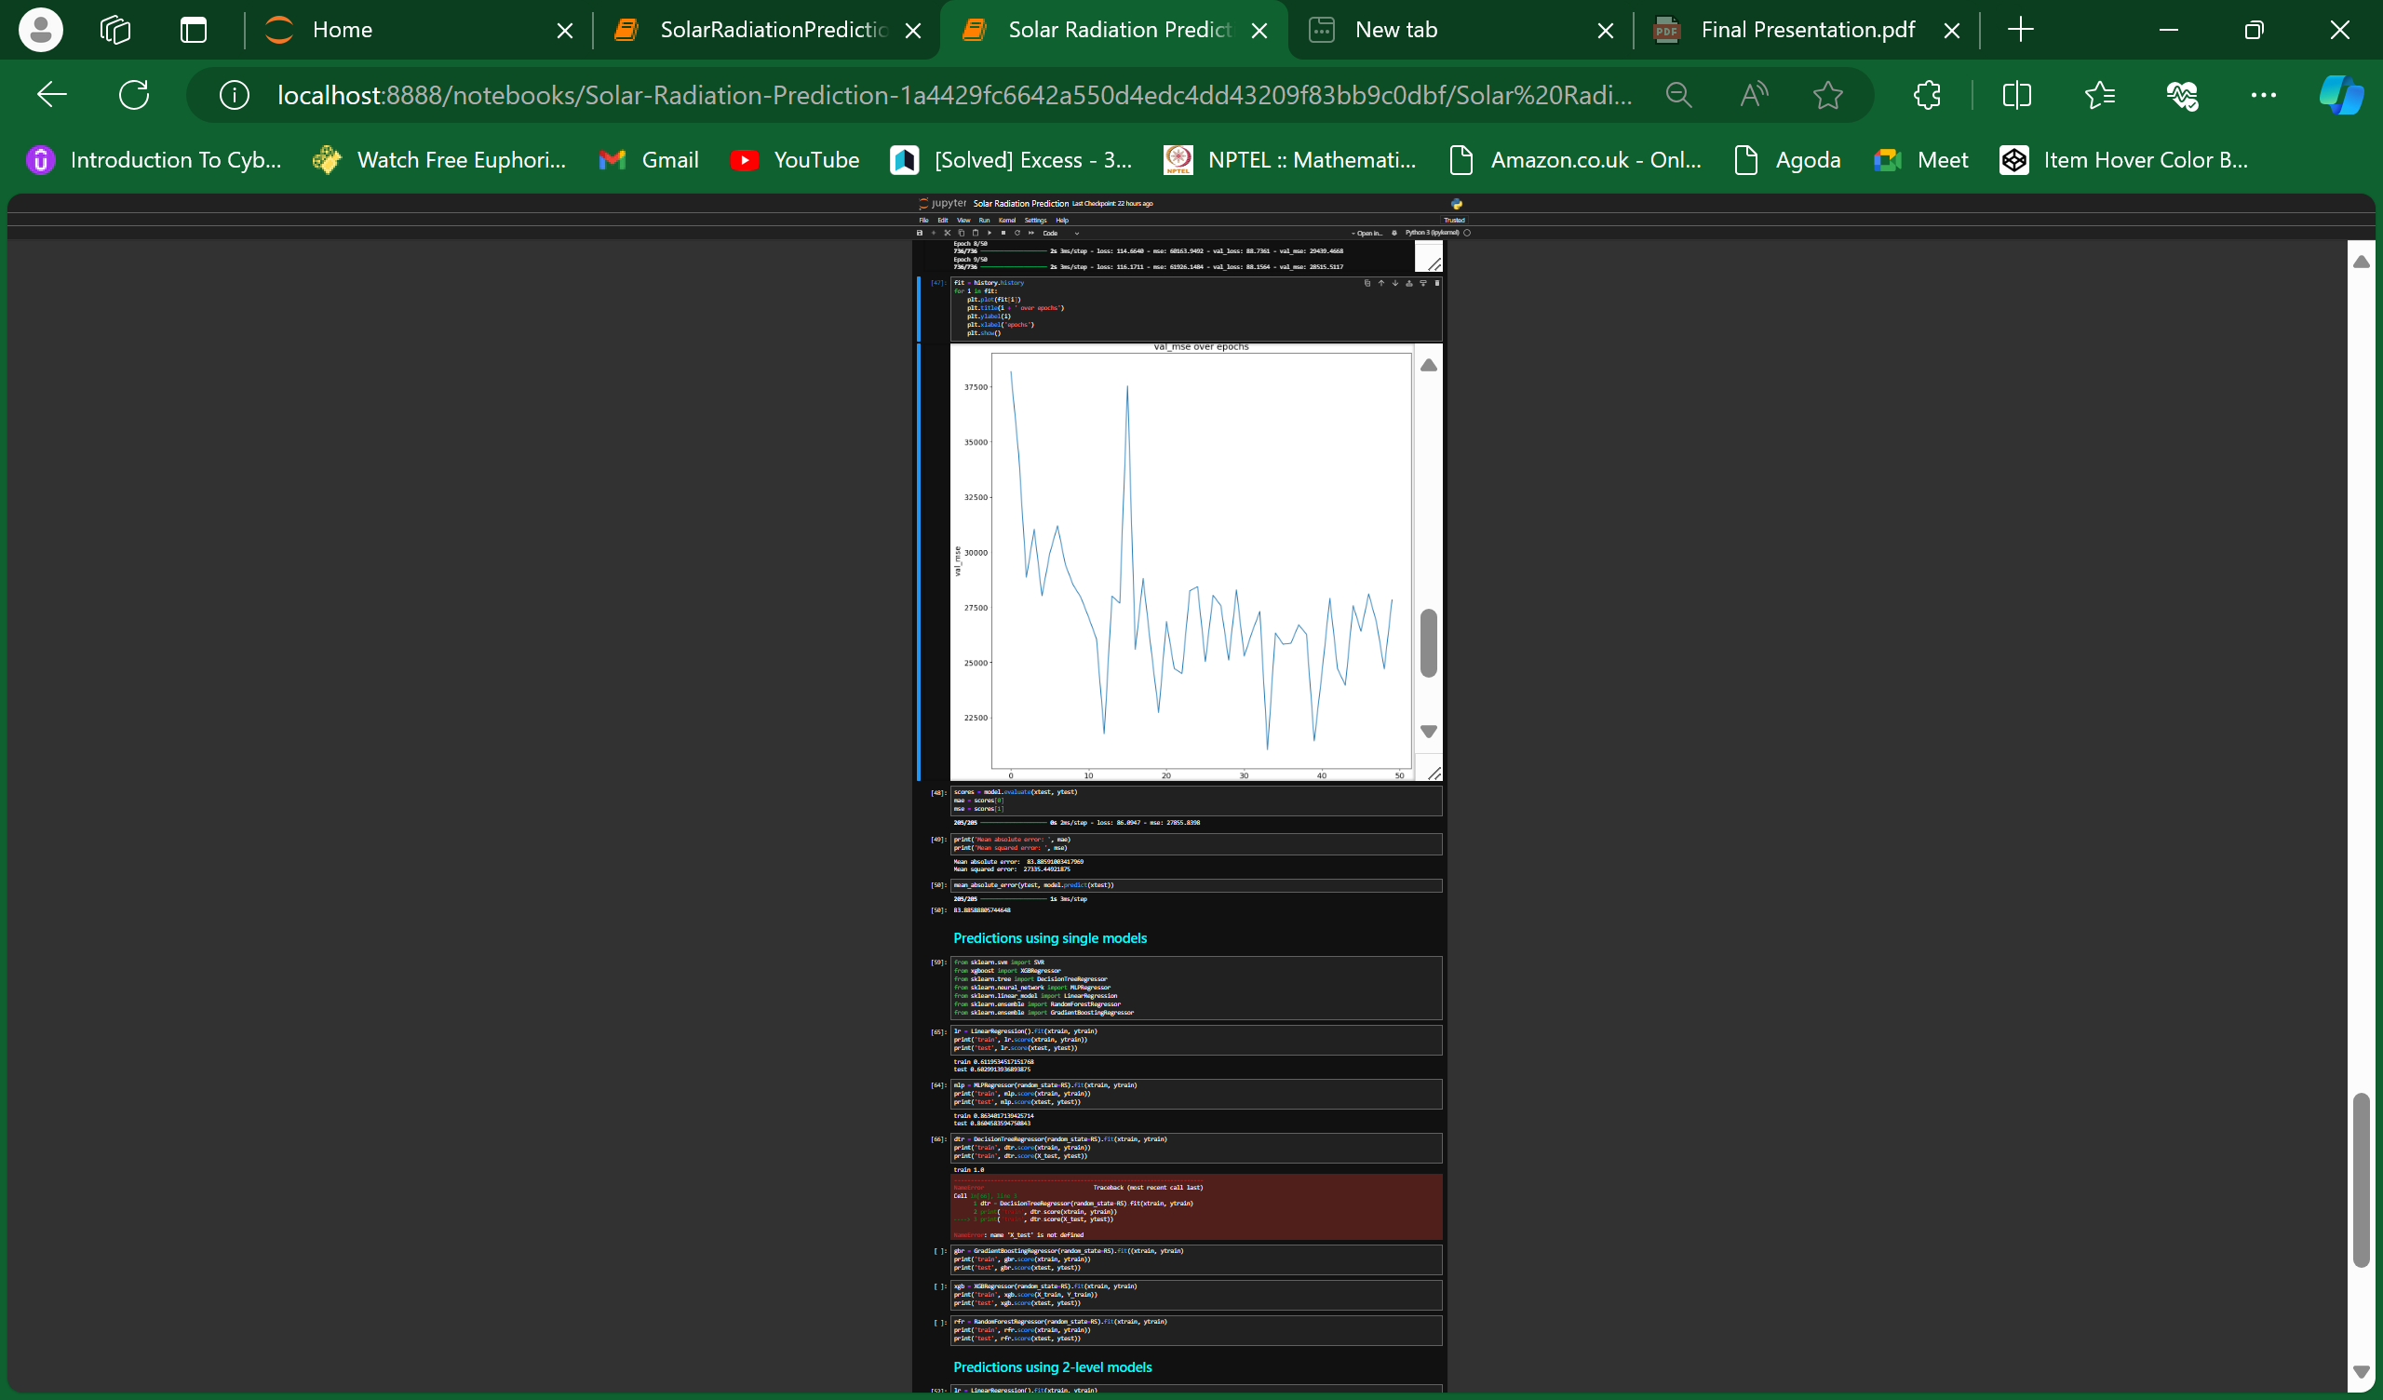
Prediction with MultiLayer Perceptron
The graph is used to monitor the performance of a machine learning model over multiple epochs.
The fluctuations indicate that the model's performance varies from epoch to epoch.
The overall decreasing trend suggests that the model is learning and improving over time.
The "best epoch" value is crucial for determining the optimal point at which the model performs best, which can be used for early stopping to prevent overfitting.

Slide 13

RESULT:

Slide 14
KEY FEATURES
Advanced Machine Learning Techniques:
Utilization of various machine learning algorithms including linear regression, support vector machines, random forests, gradient boosting, and neural networks for improved prediction accuracy.
Exploration of ensemble learning methods, such as model averaging and stacking, to enhance prediction robustness.
Comprehensive Data Collection and Preprocessing:
Collection of large-scale historical meteorological and solar radiation data from reliable sources.
Data cleansing to remove outliers, errors, and missing values, and standardization to ensure uniformity across variables.
Imputation of missing data using techniques like mean imputation, interpolation, and machine learning-based methods.
Rigorous Model Training and Evaluation:
Training of multiple models using extensive training datasets and evaluation of their performance using metrics such as mean squared error (MSE), root mean squared error (RMSE), coefficient of determination (R²), and mean absolute error (MAE).
Implementation of cross-validation techniques, including k-fold cross-validation and time-series splitting, to assess model performance and generalization ability.

Slide 15
Hyperparameter Tuning:
Fine-tuning of model hyperparameters using grid search, random search, or Bayesian optimization to optimize performance.
Adjusting hyperparameters like learning rate, regularization strength, tree depth, and number of hidden layers for improved accuracy and generalization.
Model Interpretation and Visualization:
Analysis of learned patterns and relationships within the machine learning models to understand factors influencing solar radiation prediction.
Visualization of model predictions and feature importance scores to facilitate interpretation and decision-making.
Real-World Application and Deployment:
Deployment of the predictive model in operational settings, such as solar power plants, weather forecasting systems, and environmental monitoring networks.
Continuous monitoring and periodic updates to maintain model accuracy and relevance with new data.
Significant Benefits and Impact:
Enhanced accuracy and reliability of solar radiation predictions, supporting better decision-making in solar power generation, weather forecasting, and agricultural planning.
Contribution to the optimization of solar energy systems, leading to improved efficiency, cost-effectiveness, and reduced reliance on fossil fuels.
Promotion of sustainable energy solutions and climate change mitigation efforts through advanced predictive capabilities.

Slide 16
CONCLUSION
In this study, we developed a machine learning-based approach for predicting solar radiation, leveraging historical meteorological data and advanced regression techniques. Our primary goal was to address the limitations of traditional prediction models and improve the accuracy and reliability of solar radiation forecasts.
Through our methodology, we meticulously collected and preprocessed large-scale meteorological and solar radiation datasets, ensuring data quality and consistency. Exploratory data analysis provided valuable insights into the relationships and patterns within the data, guiding the feature engineering process to extract relevant predictors for solar radiation.
We implemented various machine learning algorithms, including linear regression, support vector machines, random forests, and neural networks. By rigorously training and evaluating these models, we identified the most effective techniques for accurate solar radiation prediction. Hyperparameter tuning and ensemble learning further enhanced the models' performance, demonstrating the potential of machine learning in capturing complex atmospheric interactions.

Slide 17
Our results showcased significant improvements in prediction accuracy compared to traditional methods. The machine learning models effectively incorporated diverse meteorological variables, such as temperature, humidity, cloud cover, and wind speed, to provide reliable forecasts across different environmental conditions and geographical locations.
The successful deployment of our predictive model in operational settings highlights its practical utility for solar power generation, weather forecasting, and agricultural planning. By enabling better decision-making and resource allocation, our approach contributes to the optimization of solar energy systems and supports efforts towards sustainable energy solutions and climate change mitigation.
Overall, this project underscores the transformative potential of machine learning techniques in advancing solar radiation prediction. By harnessing big data analytics and AI, we have made significant strides towards more accurate and reliable forecasting, paving the way for enhanced efficiency and sustainability in renewable energy applications.

